Slide 1


FIVE GUYS ‘Shake it Off’ Workout
Build your own FIVE GUYS shake!
Use the FIVE GUYS Menu to create your own shake!
Your shake must include at least 2 mix ins…
Use the calorie chart to work out how many calories you need to burn in order to earn your shake. Each exercise you complete, is one step closer to your order being ready and shake being served!

Slide 2
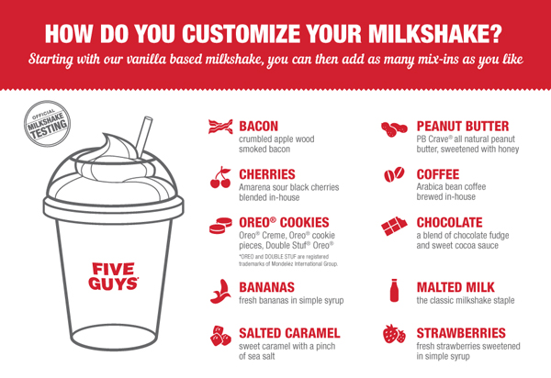
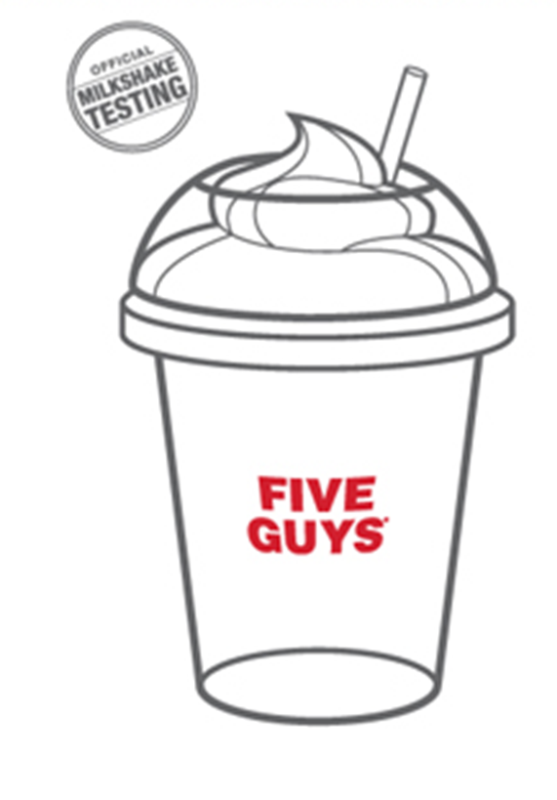
80kcal
45kcal
2
30kcal
65kcal
ADD AT LEAST 2 MIX INS!
80kcal
70kcal
3
ADD WHIPPED CREAM FOR 50Kcal!
30kcal
55kcal
1
START WITH THE STANDARD UNIQUE CREAMY VANILLA BASE (100Kcal)
75kcal
35kcal

Slide 3
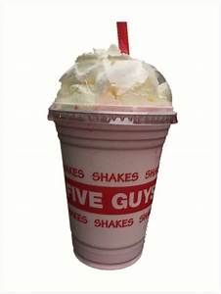
NOW ‘Shake it Off’
Exercise | Calories Burnt Off
Crunches x 15 | 10
Squat Jumps x 10 | 15
Mountain Climbers x 20 | 10
Lunges x15 | 10
Tuck Jumps x 10 | 15
Plank 30 secs | 15
Star jumps x 20 | 10
Standing Squats x 10 | 5
Burpees 15 | 20
Press Ups x 10 | 10
Plank 1 minute | 20
Extension Task – Can you burn off your friends/parents/carers favourite shake?

